Slide 1
21IPC501J Research Methodology and Publication Ethics
Prepared by –
Dr. Banu Priya P / 103206
Assistant Professor / NWC/ SOC
SRMIST, KTR

Slide 2
Module-1 – RESEARCH PREPARATION, PLANNING AND RESOURCES
Topics
Research – objectives, definitions – knowledge economy;
Perspectives of stakeholders;
Types of research;
Critical & creative thinking;
Generating research topic;
Identifying broad research question and objectives – design of questionnaire;
Characteristics of a good research – research design;
Methods of scientific enquiry – theoretical, experimental and empirical;
Hypothesis – formulation & testing.

Slide 3
Module-1 – RESEARCH PREPARATION, PLANNING AND RESOURCES
Topics
Sources of information – ICT enabled tools;
Databases, repositories, public and private sources, indexes;
Literature search – keyword;
Backward and forward search;
Quality measurement tools: journal metrics, author-level metrics;
Meta-analysis of research findings;
Literature review: grouping, analysing & comparison: Identification of research Methods;
Intellectual Property Rights;
Copyright – patent –geographical indication – industrial designs – technology transfer.

Slide 4


Research :
DEFINITIONS OF RESEARCH
Research = Re + Search
‘Re’ means again and again and ‘search’ means to find out something.
The word research is combination of “re” and “search,” which means a systematic investigation to gain new knowledge from already existing facts.
It is basically search for truth.
The following is the process,

Slide 5
DEFINITIONS OF RESEARCH
Research is a systematic process where a person repeatedly observes a phenomenon, collects and analyzes data, and then draws conclusions.
Example:
A student notices that some plants in the garden grow faster than others.
They observe this repeatedly.
They collect data on sunlight, water, and soil type.
They analyze the data to find the relation.
They reach the conclusion that plants with more sunlight grow faster.
So, research : “Carefully observing, collecting data, analyzing it, and concluding to understand or solve a problem.”

Slide 6
Research :
Research contributes significantly to the progress of the nation as well as an individual with commercial, social, and educational advantages.
Research is an important parameter to judge the development of any nation.
Research is an important component of private and government sectors.
Nowadays, interdisciplinary research is at high demand.
Research should always aim at providing efficient solutions to routine
problems.
Researchers should carefully choose the appropriate research method and follow a research process by referring to existing theories.

Slide 7
Definition of Research in Common Parlance
Research has many definitions in common parlance:
Search for knowledge
Scientific and systematic search for pertinent information on a topic
Systematic investigation of inquiry specifically searching for new facts in any discipline
Movement using known facts to unknown or unexplained issues
Art of scientific investigation
Voyage of discovery
Events primed by inquisitiveness as driving force
Academic activity used in a technical sense

Slide 8
DEFINITIONS OF RESEARCH
Research refers to the systematic method consisting of enunciating the problem, formulating a hypothesis, collecting the facts or data, analyzing the fact and reaching certain conclusions either in the form solutions(s) towards the concerned problem or in certain generalizations for some theoretical formulation.

Slide 9

STAGES OF RESEARCH
Selection of a Research Topic
Definition of a Research Problem
Literature Survey and Reference Collection
Assessment of Current status of the topic chosen
Formulation of hypothesis
Materials and Methods (Research Design)
Conduct of Experiments (Actual Investigations)
Data Analysis
Interpretation of the Results
Findings and conclusions

Slide 10
Technical Definitions of Research
Defining and redefining problems, formulating hypothesis or suggested solutions, collecting, organizing and evaluating data, making deductions and reaching conclusions, and at last carefully testing the conclusions to determine whether they fit the formulating hypothesis. (Clifford Woody)
The manipulation of things, concepts or symbols for the purpose of generalizing to extend, correct or verify knowledge, whether the knowledge extends to the construction of a theory or the practice of an art. (Slesinger and Stephenson)
Research is a tool that is building a block and a sustaining pillar of every discipline — scientific or otherwise that one knows.
Research refers to the systematic method consisting of enunciating the problem, formulating a hypothesis, collecting the facts or data, analyzing the fact and reaching certain conclusions either in the form solutions(s) towards the concerned problem or in certain generalizations for some theoretical formulation.

Slide 11

Objectives of Research:
OBJECTIVES OF RESEARCH
The main purpose of research is to find solutions to unsolved problems using
scientific procedures and also to understand various phenomena scientifically.
In addition, one of the major objectives of research is to find out a hidden,
undiscovered truth.
There are various objectives behind undertaking research by individuals as well as various organizations.

Slide 12
Objectives of Research
The purpose of research is to discover answers to questions through the application of scientific procedures. The main aim of research is to find out the truth which is hidden and which has not been discovered as yet. The objectives may be classified as:
To gain familiarity with a phenomenon or to achieve new insights into it (studies with this object in view are termed as exploratory or formulative research studies)
To portray accurately the characteristics of a particular individual, situation or a group (studies with this object in view are known as descriptive research studies)
To determine the frequency with which something occurs or with which it is associated with something else (studies with this object in view are known as diagnostic research studies)
To test a hypothesis of a causal relationship between variables (such studies are known as hypothesis-testing research studies)

Slide 13
Research and Knowledge Economy
A poorly developed country is agriculture and manufacturing - based economy
A developing country is manufacturing and service - based economy
A developed country is knowledge - based economy
Knowledge economy is a system of consumption and production based on intellectual capital, which refers to the ability to capitalize on discoveries emanating from basic and applied research
Hence, a significant contribution to the knowledge - economy emanates from intangible assets such as research, technical support, and consulting and intellectual property rights and royalties
Hence, research plays an important part in the growth of an economy

Slide 14
Research and Stakeholders Perspectives
Stakeholders are individuals or organizations who have an interest in your research project, or who affect or are affected by its outcomes.
The Public
The media
Public sector
Schools, Colleges and lifelong learning
Communities of interest
Cultural and leisure services
Communities of place
Health and well being agencies
Non Governmental organizations
Policy Community
Quangos and govt. agencies
Community organizations
And societies
Community and 3rd sector
Local / regional / national govt.
Local authority / strategic bodies
Voluntary organizations
And Charities
International Community
Business and industry
Social enterprises
Business Community

Slide 15
Research and Stakeholders Perspectives
They maybe groups and organizations, such as funders, donors, community members, advocacy organizations, patients, trade associations, businesses, policymakers, policy advocates (NGO), and product developers.
A stakeholder may serve multiple roles and bring several perspectives to a project: setting priorities, shaping the research questions, designing or Implementing studies, funding programs, assessing applications, communicating findings, and moving the results into practice.
Importantly. stakeholder engagement can bring knowledge and expertise different experiences and perspectives to your research, provide data and resources, build shared understanding, and make information from your research relevant for effective decision making.
Hence stakeholders perspectives play a significant role in research

Slide 16
Types of Research
Types of research may be categorized depending on applicability, the mode of enquiry in conducting the study, and major objectives of the study. In fact, a research problem may use multiple research types.
Ref : Research Methodology A Practical and Scientific Approach, Biragi and Munot, CRC Press, 2019
Descriptive Research
Correlational Research
Analytical Research
Experimental Research
Types of Research
Explanatory Research
Exploratory Research
Quantitative Research
Qualitative Research
Basic Research
Applied Research

Slide 17


Pure Research (or) Basic (or) Fundamental (or) Theoretical Research:
TYPES OF RESEARCH AND ITS GOALS
There is no immediate need, but new theories can be added to the knowledge cluster.
This type of research may solve problems but may not have practical applications.
It has a broader scope compared to applied research.
Research concerning some natural phenomenon mathematics are examples.
or relating to pure
Example: Newton’s laws of motion.
This has been applied in many product design and testing.

Slide 18
Applied Research:
Applied Research tries to solve an immediate specific problem faced by industry or society.
The obtained solution can be deployed to solve the problem.
The duration of applied research is shorter as a quick solution is expected.
The outcome of the applied research either address the unsolved problem or improve the existing solution.
Example:
1. An optimized search problem on the Internet is an example of applied research in the computer engineering domain.

Slide 19
Example:
2. “Analysis of cell/body organ behavior in cancer” is an example of hybrid research.
A researcher may use data analytics, image processing, algorithms, and knowledge of the medical industry.
Distinguish between pure research and applied research?
Pure research enriching the theory whereas applied research enriches the application of the theory.

Slide 20

Types of Research
Descriptive Research — Ex post facto research
To portray accurately (survey) the characteristics
of a particular individual, situation or a group.
Mostly involves primary data — the researcher
has no control over the variable — he can only report
what has happened or what is happening. (Ex post factor)
Some examples are:
Number of man-days lost in a factory because of accidents
Number of COVID related deaths due to the pandemic
Gender, age and other demographics of a population
DESCRIPTIVE RESEARCH

Slide 21
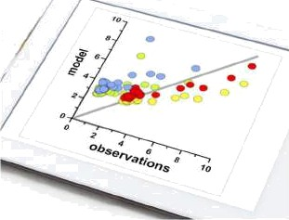
Types of Research
Correlation Research — constructing models
To establish the existence of relationships
between two or more aspects of a situation
It explores the relationship or association
between incidences, variables etc.
Examples include:
Effect of cigarette smoking on incidences of lung cancer
Effect of modern lifestyle on obesity
Effect of leaf length on leaf weight

Slide 22

Types of Research
Analytical Research - cause and effect
Analytical research focuses on cause and effect.
It tells us why our certain hypothesis is true or false,
which requires critical thinking skills and careful
assessment of the facts.
Examples are:
Why has the value of INR slid down against the US Dollar
over the last three decades.
What is the cause for the high rate of suicides in a highly
educated society

Slide 23

Types of Research
Experimental Research
It is a study that adheres to a scientific
research design.
It includes a hypothesis, a dependent
variables that can be manipulated by the
researcher, and independent variables that can be measured,
calculated and compared.
The researcher collects data and results will either support or reject the hypothesis.
Example of this is the type of research where investigator optimizes the desired independent variable by manipulating the dependent variables.

Slide 24

Types of Research
Explanatory Research
It is also called causal research and tries to analyse and justify the reason behind the occurrence of particular phenomenon or association between the variables.
It basically answers the “Why” type of questions.
It aims to explain why a relationship, association, or interdependence exist.
Example is: Why do customers prefer to purchase a certain colour packaged items more than others

Slide 25

Types of Research
Exploratory or Formulative Research —
Explore new frontiers
To gain familiarity with a phenomenon or
to achieve new insights into it.
It does not aim to provide a conclusive
answer to the research questions, but merely
explores the research topic to help develop a hypotheses (rather than
its testing).
Example is a product launch in a particular city to judge the customer
response before it can be launched nation-wide.
EXPLORATORY
RESEARCH

Slide 26


Types of Research
Quantitative Research
As the name suggests, this involves measurements of quantities of a particular characteristic that can be used for the research study.
It uses statistical analysis on parameter values to reach conclusions.
Example is the number of fatalities of the COVID pandemic with respect to different criteria such as rural, urban residents, region-wise, educational qualification etc.
Qualitative
Quantitative

Slide 27

Types of Research
Qualitative Research
This research is about “what” people think and “why” they think so.
So, it deals with human behaviour
So it is empirical research where data are not in the form of numbers.
It is based on the disciplines of social sciences like psychology, sociology, and anthropology.
Example is the study of the behavioural response of employees to the
changes occurring in an organization.
Qualitative Research

Slide 28

Types of Research
Basic Research is pure or fundamental
research.
It aims to obtain a better understanding
of a subject, phenomenon or basic law
of nature.
This type of research is primarily focused
on the advancement of knowledge rather
than solving a specific problem.
Theories in basic sciences and
mathematics are examples of
basic research.

Slide 29

Types of Research
Applied Research
Applied research tries to solve an
immediate specific problem faced by
society.
The obtained solution can be
deployed to solve the problem.
The outcome of applied research should
either address the unsolved problem or
improve the existing solution.
Example of applied research is the discovery of drugs to treat diseases

Slide 30
Types of Research
Some other types of research are:
Diagnostic Research — to determine the frequency with which something occurs or with which it is associated with something else (Health Science).
Hypothesis-Testing Research — to test a hypothesis of a causal relationship between variables by forming suitable hypotheses (model assisted studies).
Overt and Covert Research — overt research means that everyone knows who the researcher is and what research is being conducted. Covert research means that it is an under-cover work and nobody knows who the researcher is and what researcher is being conducted.

Slide 31
Classification of Research
Basic Research
Applied Research
Enriching the theory
Enriching the applications of theoretical knowledge

Slide 32
Classification of Research
Basic research | Applied Research
It more theoretical also explores the information that have not applied yet | Applied research is more practical and descriptive in nature
The scope of basic research is often universal at can be applied in diverse concepts | The scope of applied research is largely focused on the particular topic to get the answer
It is lesser involved in improvement of technology | It is comparatively highly applied to improve the technology and covers the larger areas
It aims to predict future research and analyze the gap between the researches prior done | Applied seeking to prevent the predicted problem having potential to create challenges in the future
It is driven by curiosity | It is usually driven by clients and conducted to understand the fundamental concept required to solve the peoples problem
In case of basic research, it is primarily applicable to academic areas | It is closely linked to commercial products
Basic research occurs in highly sterile and controlled environment | It takes place in world setting where other unexpected variable may intervene
Example - Research on identifying secondary symptoms of human papilloma virus | Example- Research into marijuana healing properties
It approaches flexible time scales where choices of the topic is determined by the researchers | It approaches tight time scale where objectives are negotiated with originator

Slide 33
Classification of Research
Overt Research
Covert Research
Everyone knows
who the researcher is and what research is being conducted
Under-cover work
and nobody knows who the researcher is and what research is being conducted

Slide 34
Classification of Research
Applied in natural sciences
Hypothesis driven, e.g. Null, alternate
Data collection to establish cause and effect relationship
Narrow scope
Applied mostly in sociological sciences
Hypothesis not essential
Wide scope
Experimental Research
Non – experimental Research
Portray (survey) the characteristics of a particular individual, situation or group
e.g. Gender, age and other demographics of a population survey
Explore a topic to develop a hypothesis
e.g. New product launch in a city
Exploratory Research
Descriptive Research
Data at a given point of time
e.g. Pre – poll survey
Time – dependent survey data
What happened in history, say during the reign of Ashoka.
Static
Dynamic
Historical
Cross - sectional
Panel Study
e.g. Gender, age and other demographics survey over short period of time, say every 5 years
Survey over long period of time

Slide 35
Research Methods vs. Research Methodology
Research methods may be understood as all those methods/ techniques that are used for conduction of research.
Since the object of research, particularly the applied research, is to arrive at a solution for a given problem, the available data and the unknown aspects of the problem have to be related to each other to make a solution possible.
Keeping this in view, research methods can be put into the following three groups:
In the first group we include those methods which are concerned with the collection of data, e.g. experimental (instrumental) methods, survey etc.
The second group consists of those statistical techniques which are used for establishing relationships between the data and the unknowns
The third group consists of those methods which are used to evaluate the accuracy of the results obtained

Slide 36
Research Methods vs. Research Methodology
Research methodology is a way to systematically solve the research problem in a logical step-by-step manner.
Hence, It is necessary for the researcher to know not only the research methods / techniques but also the methodology.
The scope of research methodology is wider than that of research methods.
Thus, when we talk of research methodology we not only talk of the research methods but also consider the logic behind the methods we use in the context of our research study
Explain why we are using a particular method or technique and why we are not using others so that research results are capable of being evaluated either by the researcher himself or by others.

Slide 37
Attributes of Good Researcher Role of Critical Thinking and Creative Thinking
A good researcher should possess technical as well as professional skill-sets
The technical skill-set deals with domain knowledge and requires critical thinking
The professional skill – sets deal with the other aspects, including creative thinking mentioned in the figure
Both critical and creative thinking are essential for research
Creativity
Creative Thinking
Dedication and Commitment
Ingredients for Good Researcher
Verbal Communication
Consistency and Patience
Domain Knowledge
Written Communication
Critical Thinking

Slide 38
Critical Thinking vs. Creative Thinking
Critical thinking is the ability to clearly and logically evaluate information that is presented. So, it is an analytical action.
It can also be defined as the purposeful and reflective judgment about what to believe and what to do in response to the observations, experience, verbal or written expressions or arguments.
Creative thinking is about reflecting on different perspectives or truths and then generating new, novel, or useful ideas. So, it is an generative action.
Critical and Creative thinking are complementary skills which are used in different stages when trying to solve a problem or forming a judgment about something.

Slide 39
Critical Thinking and Bloom's Taxonomy
Critical thinking is the ability to clearly and logically evaluate information that is presented to us. So, it is an analytical action.
Bloom’s Taxonomy Framework
Creating
Higher Order Abilities
Evaluating
Higher Order Abilities
Analyzing
Applying
Understanding
Lower Order Abilities
Remembering

Slide 40
Tools of Critical Thinking
There are four stages in critical thinking:
Collecting data
Evaluating it
Drawing logical conclusions and
Evaluating the validity of the conclusion
Non – Critical Thinker
Critical Thinker
Collects Information
Collects Information
Evaluates Information
Draws Conclusions (without Logic)
Evaluates Logical Conclusions
Draws Conclusions (using Logic)

Slide 41
Stages of Research
Selection of Research Area / Topic
Definition of Research Problem
Literature Survey and Reference Collection
Assessment of Current Status and Formulation of Problem Statement
Modeling New Theories
Existing Models
Formulation of Hypothesis
Research Design – Materials and Methods
Conduct of Experiments (Actual Investigations and Collect Data)
Data Analysis
Interpretation of Results
Findings and Conclusions

Slide 42
Research Problem Identification of Research Area and Topic
Choice of Research Area of the problem maybe motivated by:
Interest of the researcher due to self or other close associates
Previous domain knowledge of the researcher
Results of a critical literature survey of the donna in/area of interest
A guide can supervise, but it is the student who has to decide on the research
area, topic and particular problem
Important points to be taken into account
Over explored research areas to be avoided
Controversial research areas to be avoided
Very narrow or too vague problems to be avoided
Familiar and feasible subjects (for guide) to be chosen
Research significance, researcher background, cost estimate and time factor to
be considered
Preliminary study needed before deciding on the work

Slide 43
Research Problem Identification of Research Area and Topic
Choice of Research Topic is identified based on combination of
Specialization
Domain knowledge
Interesting or challenging topic
Doable within a specific time frame
Guidance of supervisor
Discussion with peers and experts
Critical literature survey to identify gaps of knowledge

Slide 44
Research Problem Originality (Novelty)of Research Area and Topic
The originality can be confined to:
New interpretation to support known facts
e.g. COVID infection using known spike protein amino acid sequence
Unearthing new evidences to support known facts
e.g. Mutant COVID infection using new spike protein amino acid sequence
Proposing new concept to explain a known phenomena
e.g. cellular signaling mechanism involving progression of a disease, say cancer metastasis
Proposing a new model to explain a known phenomena
e.g. mathematical model predicting the descent of a rover onto the surface of the Moon

Slide 45
Research Problem Originality (Novelty)of Research Area and Topic
Utilization of a novel technique in an untested area
e.g. mass spectrometry based secretomics for cancer biomarker discovery
Utilization of a novel methodology to solve a known problem
e.g. controlled real-time response based release of insulin into the blood stream to maintain sugar level
Empirical work that is not repeat of an earlier work
Furthering the work of some earlier researcher as suggested in his/her thesis or publication
Creative and critical thinning should foster cross-breeding of ideas and applications in different contexts to solve problems.

Slide 46
Research Problem Approach for Selection of Research Area and Topic
There is no universal approach for this! One approach is:
A direction or research interest area is chosen based on the background
of the researcher
A set of keywords is compiled for searching of literature
A set of recent and well cited review articles, say 15 to 20 is chosen that is related closely to
what was chosen as area by the researcher
The keywords are refined further to identify related recent as well as distant past
research publications. Cross referencing may be used for literature search.
The emphasis (problem addressed, challenges overcome, solution proposed, novelty in
methodology, conclusions etc.) of each article is noted down

Slide 47
Research Problem Approach for Selection of Research Area and Topic
The emphasis of the article in following terms is noted:
Problem addressed
Approach methodology employed — metrics, evaluation tools, data interpretation, result
analysis
Challenges overcome
Solutions proposed
Significance of conclusions
Based on this some questions can be asked:
Is same approach methods and methodology used in all articles and can be it be replaced
with better ones
If so, what are the advantages and disadvantages etc.
Is further exploration possible in the research area etc.

Slide 48
Research Problem Approach for Selection of Research Area and Topic
Other approaches are:
Research focus areas of funding agencies such as DST, DBT, ICMR, DRDO etc. are:
Cleantech - clean technology for fossil fuels
Carbon capture and storage — environmental aspects
Biorefinery — efficient utilization of natural resources
Defense and Aerospace — space research
Food and Agriculture — nutrition and self sufficiency
Electric and hybrid vehicles — smart vehicles and alternate fuels
Electronic Systems and Manufacturing - Semi-conductor tech.
New and renewable energy - solar, wind etc.
Advanced and Smart Manufacturing
Biotechnology - Vaccine production, recombinant tech. etc.
BiomedicaI research — fundamental and applied disease research, equipment's

Slide 49
Research Problem Approach for Selection of Research Area and Topic
Other non-regular approaches are (contd.):
Industrial R & D activities and its budgets as per annual reports of
companies
Latest edition text books of emerging areas
Further scope of research as mentioned in PhD theses
Discussion with experts
Attending seminars, conferences to listen to experts
Based on all these, a one or two-page summary of the research area,
specific topic of interest and its current status can be documented. This
can be used to the formulate the problem statement.

Slide 50
Research Problem Statement Introduction
The first step in solving any research problem lies in first clearly identifying and stating the nature of the problem.
Such a statement is called as a “Problem Statement” and hence can be defined as a clear description of a problem that needs to be solved.
This simple, yet effective problem-solving technique (which forms part of the design thinking process) requires breaking down the problem by asking questions such as “who does it affect?” and “how does the problem make the stakeholders feel?” etc., so the issue maybe stated in a concise manner and quickly and easily understood by all stakeholders.

Slide 51
Problem Statement Formulation Problem Definition “A problem well defined is a problem half- solved”
Defining a problem involves laying down boundaries within which a researcher shall study the problem with a predetermined objective.
It is important to develop a well developed problem definition early in the research to focus on the deliverables of the specific objectives.
Answer to questions such as the ones that follow will help in this task:
What are the data to be collected?
What are the relevant characteristics of this data?
What are the relations that need to be explored?
What are the methods, techniques etc. to be used?

Slide 52
Problem Statement Formulation Suggested Techniques / Steps
The following 5 steps maybe utilized for the formulation
1. General Statement of the Problem
The research problem is stated in a general and broad manner keeping in mind the probable strategy for the solution
2. Understanding the Problem
Origin and nature of the problem can be understood by reading news papers and magazines, general literature etc. The research problem could be discussed with guide and fellow students.
3. Surveying Literature
A broad reading of available literature provides an idea about the shortcomings, difficulties, challenges and probable analytical solutions to the issues concerning the research area. This helps to narrow down the topic.

Slide 53
Problem Statement Formulation Suggested Techniques / Steps
Finally, the problem statement should also take care to explain hypothesis, technical terms, assumptions made, criteria for selection of research problem area and topic, source of data to be acquired, type of data analysis, scope and limitations if any and anticipated solution etc.
4. Develop Ideas through Discussion
Discussion with fellow researchers, guide, experts etc. will help to narrow down to the particular research problem and topic as well as probable solutions.
5. Rephrasing the Problem Statement
The research problem can be formulated into a working proposition. This maybe an iterative process starting again with the first “General Statement” step.

Slide 54

Questionnaire
A questionnaire is a research instrument
consisting of a series of questions (or other
types of prompts) for the purpose of gathering
information from respondents through survey
or statistical study.
A questionnaire is a formalized set of questions
to generate the data necessary for a accomplishing a research
project's objectives.
In general, questions should flow logically from one level to the next
higher level of complexity.

Slide 55
Designing a Questionnaire Ten Points to be Considered
1. Must be initially related to final objectives of the investigations
Specify the information needed
2. Questions must follow logical sequences
Arrange the questions in proper order
3. Specify the type of interviewing method
Biased questions should be avoided
4. Proper structuring of the question is must
Decide on the question structure
5. Should be brief, clear and simple
Determine the content of individual questions
Determine the question wording

Slide 56
Designing a Questionnaire Ten Points to be Considered
6. Reproduce the questionnaire
Question should have appropriate and to it
7. Eliminate bugs by pretesting
Conflict between interviewer and respondent should be avoided
8. Questions outside the respondents experience should not be asked
To overcome the respondent's unwillingness to answer
9. Questions should test the memory of the respondent
To overcome the respondent‘s inability to answer
10. Identify the form and layout
To gather factual data

Slide 57

Hypothesis Introduction and Definition
In common parlance, hypothesis simply states
a mere assumption or some supposition to be
proved or disproved.
A hypothesis is written in such a way that it can
be proven or disproven by valid reliable data.
(Griennell & Stothers)
A tentative statement about something, the validity
of which is usually unknown. (Black & Champion)
In other words, it can be said that a hypothesis is a hunch, assumption, suspicion, assertion or an idea about a phenomenon, relationship or situation, the reality or truth of which is not known.

Slide 58
Functions of an Hypothesis
A hypothesis though not an essential feature, brings clarity to the research with the following functions:
The formulation of a hypothesis provides a study with focus. It tells what specific aspects of a research problem to investigate.
A hypothesis tells what data to collect and what not to collect, thereby providing focus to the study.
As it provides a focus, the construction of a hypothesis enhances objectivity in a study.
A hypothesis may enable the researcher to add to the formulation of theory. It helps in concluding specifically what is true or what is false.

Slide 59
Characteristics of an Hypothesis
A hypothesis must possess following characteristics:
Hypothesis should be clear and precise. If the hypothesis is not clear and precise, the inferences drawn on its basis cannot be taken as reliable. In other words, it should be non contradictory one.
Hypothesis should be capable of being tested. In a swamp of untestable hypotheses, many a time the research programmes have bogged down.
Hypothesis should state relationship between variables, if it happens to be a relational hypothesis.
Hypothesis should be limited in scope and must be specific. It Should be remembered that narrower hypotheses are generally more testable

Slide 60
Characteristics of an Hypothesis
5. Hypothesis should be stated as far as possible in most simple terms so that the same is easily understandable by all concerned
6. Hypothesis should be consistent with most known facts i.e., it must be consistent with a substantial body of established facts.
7. Hypothesis should be amenable to testing within a reasonable time.
8. Hypothesis must explain the facts that gave rise to the need for explanation. This means that by using the hypothesis plus other known and accepted generalizations, one should be able to deduce the original problem condition.

Slide 61
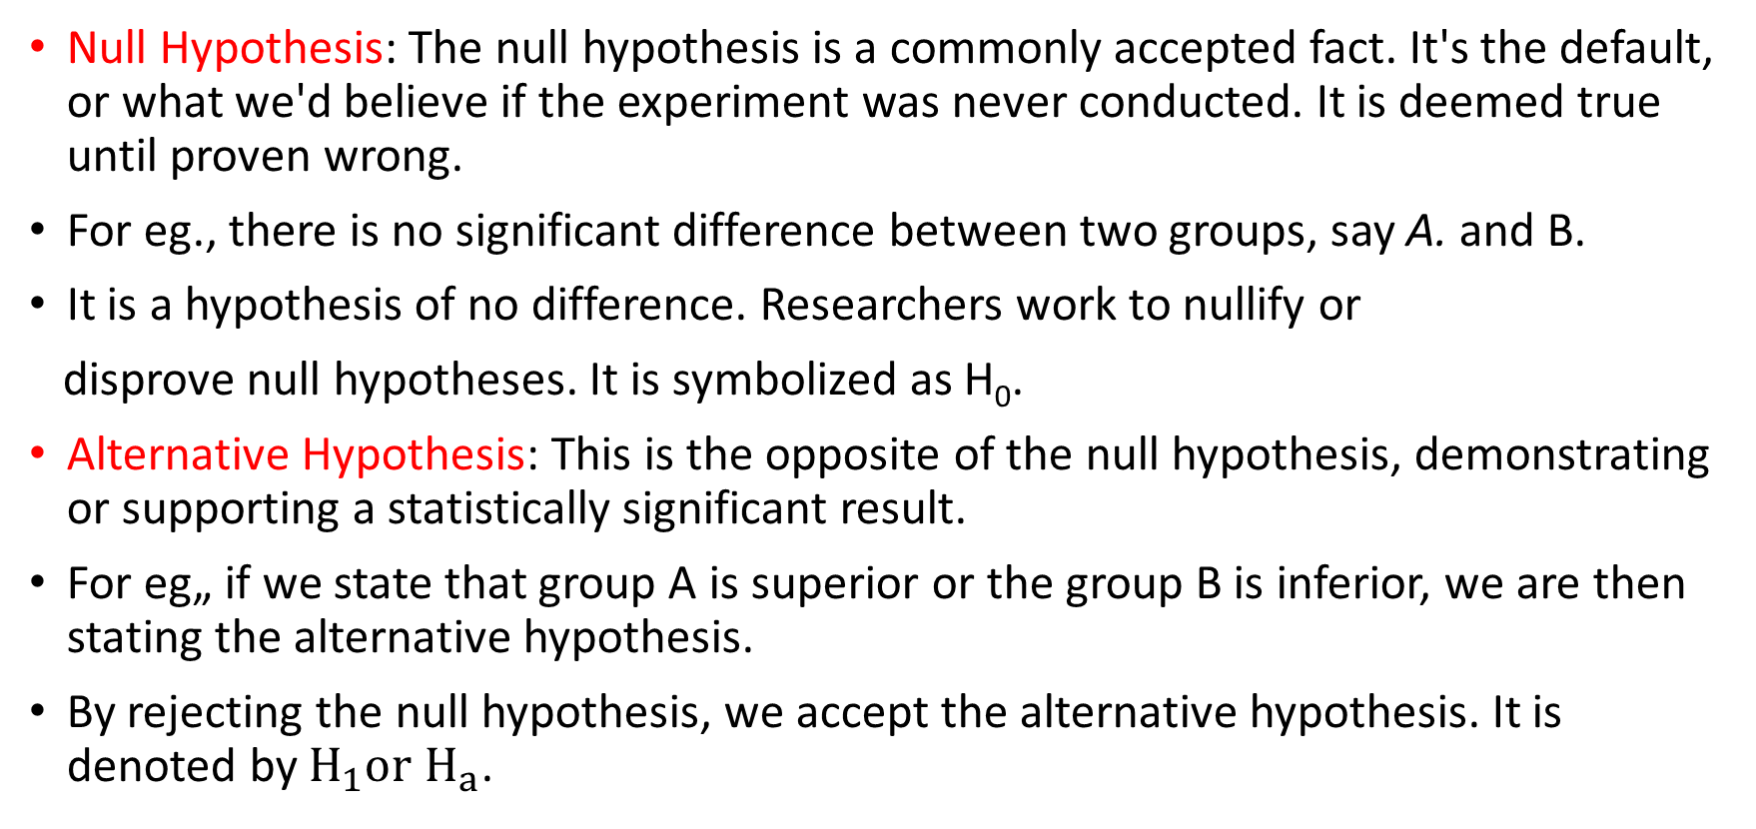
Types of Hypothesis
Null Hypothesis: The null hypothesis is a commonly accepted fact. It's the default, or what we'd believe if the experiment was never conducted. It is deemed true until proven wrong.
For eg., there is no significant difference between two groups, say A. and B.
It is a hypothesis of no difference. Researchers work to nullify or
disprove null hypotheses. It is symbolized as H₀.
Alternative Hypothesis: This is the opposite of the null hypothesis, demonstrating or supporting a statistically significant result.
For eg„ if we state that group A is superior or the group B is inferior, we are then stating the alternative hypothesis.
By rejecting the null hypothesis, we accept the alternative hypothesis. It is denoted by $H_{1}or$ $H_{a}$.

Slide 62
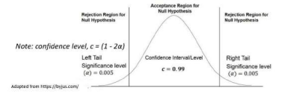

Level of Statistical Significance ($α$)
Level of significance ($α$): The level of significance is defined as the probability of wrong elimination of null hypothesis when in fact, it is true. It is the opposite of the confidence level (denoted by c). The c level is usually set ranging from 0.1 to 0.005 (10% to 0.5%).
An $α$ = 0.05 means 5% chance of finding alternate hypothesis to be true, thereby rejecting null hypothesis, when in actuality, null hypothesis is true.
In the case of the effect of fertilizer on plant growth example, it is the probability that the null hypothesis of no effect of fertilizer on plant growth is rejected when it is indeed true.
The success of the statistical test depends on the availability of correct and reliable data and researchers skill in interpreting the results

Slide 63
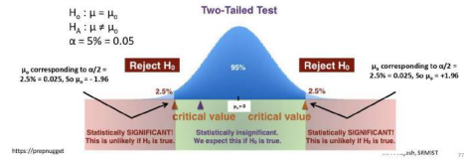

Two – Tailed and One – Tailed Test
The two-tailed test is applicable when a given H, may be rejected with the value of the statistic being either sufficiently small or sufficiently large.
$H_{1}$: $μ≠ μ_{0}$, because either $μ> μ_{0}$ or $μ < μ_{0}$
Hence there are two rejection regions. The $H_{0}$is rejected if the sample mean falls in either one of the two-tail regions under the far left or far right of the distribution. Please note $μ_{0}= ± 1.96$ for $α$= 0.05 which maybe obtained from tables in the figure below.

Slide 64
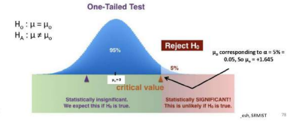

Two – Tailed and One – Tailed Test
The one-tailed test is applicable when a given $H_{0}$ may be rejected with the value of the statistic being sufficiently large (in the second case it might be sufficiently small).
$H_{1}$: $μ≠ μ_{0}$, because $μ> μ_{0}$ (in the second case $μ < μ_{0}$)
Hence there is one rejection region. The $H_{0}$is rejected if the sample mean falls in the single tail region under the far right (second case being far left of the distribution). Please note $μ_{0}= + 1.645$ for $α$= 0.05 which maybe obtained from tables in the figure below.

Slide 65
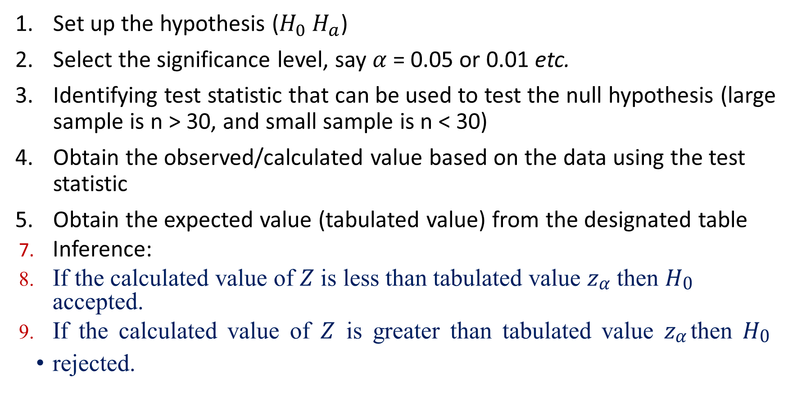
Hypothesis Testing Procedure
Set up the hypothesis ($H_{0} H_{a}$)
Select the significance level, say $α$= 0.05 or 0.01 etc.
Identifying test statistic that can be used to test the null hypothesis (large sample is n > 30, and small sample is n < 30)
Obtain the observed/calculated value based on the data using the test statistic
Obtain the expected value (tabulated value) from the designated table
Inference:
If the calculated value of 𝑍 is less than tabulated value 𝑧_{𝛼} then 𝐻₀ accepted.
If the calculated value of 𝑍 is greater than tabulated value 𝑧_{𝛼} then 𝐻₀
rejected.

Slide 66
Hypothesis Testing with Example
A manufacturer of switches claims that data obtained over the years, show that their switches lasts for a mean of 2,000 hours with a standard deviation of 200 hours.
Later, the R&D department claimed that they have came up with some innovation that might extend the life of the switches.
To test this, the company conducted a test with 100 switches which showed that the they now had an mean life of 1,960 hours with a standard deviation of 180 hours.
Based on these results, can the manufacturer claim that this has led to a change in the life span of the switches? Frame a hypothesis and test it with a significance level of 5%.

Slide 67
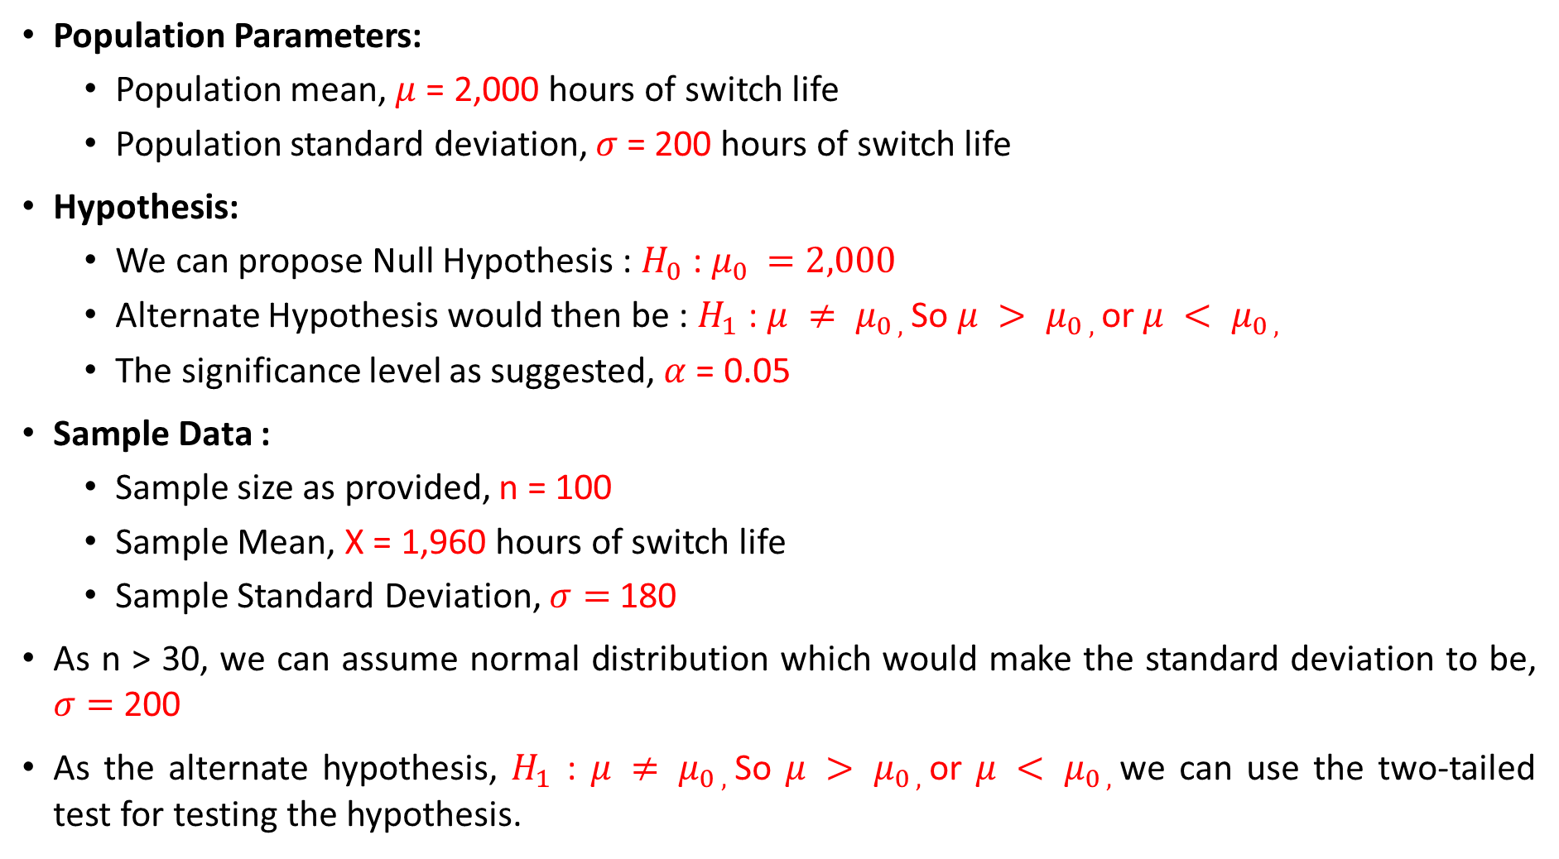
Hypothesis Testing with Example
Population Parameters:
Population mean, $μ$= 2,000 hours of switch life
Population standard deviation, $σ$ = 200 hours of switch life
Hypothesis:
We can propose Null Hypothesis : $H_{0}$ : $μ_{0 }=2,000$
Alternate Hypothesis would then be : $H_{1}$ : ${μ ≠ μ}_{0 , }$So ${μ > μ}_{0 , }$or ${μ < μ}_{0 , }$
The significance level as suggested, $α$= 0.05
Sample Data :
Sample size as provided, n = 100
Sample Mean, X = 1,960 hours of switch life
Sample Standard Deviation, $σ=$180
As n > 30, we can assume normal distribution which would make the standard deviation to be, $σ=$ 200
As the alternate hypothesis, $H_{1}$ : ${μ ≠ μ}_{0 , }$So ${μ > μ}_{0 , }$or ${μ < μ}_{0 , }$we can use the two-tailed test for testing the hypothesis.

Slide 68
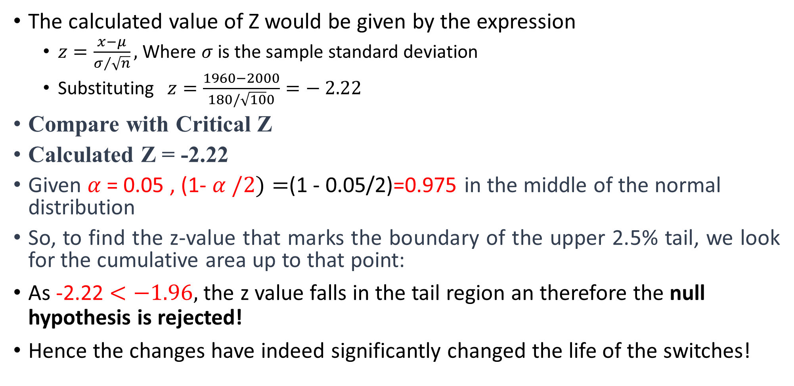
Hypothesis Testing with Example
The calculated value of Z would be given by the expression
$z=\frac{x−μ}{σ/{\sqrt{n}}},$Where $σ$ is the sample standard deviation
Substituting $z=\frac{1960−2000}{180/\sqrt{10}0}=− 2.22$
Compare with Critical Z
Calculated Z = -2.22
Given $α$= 0.05 , (1- $α /2)=$(1 - 0.05/2)=0.975 in the middle of the normal distribution
So, to find the z-value that marks the boundary of the upper 2.5% tail, we look for the cumulative area up to that point:
As -2.22 $<−1.96,$the z value falls in the tail region an therefore the null hypothesis is rejected!
Hence the changes have indeed significantly changed the life of the switches!

Slide 69
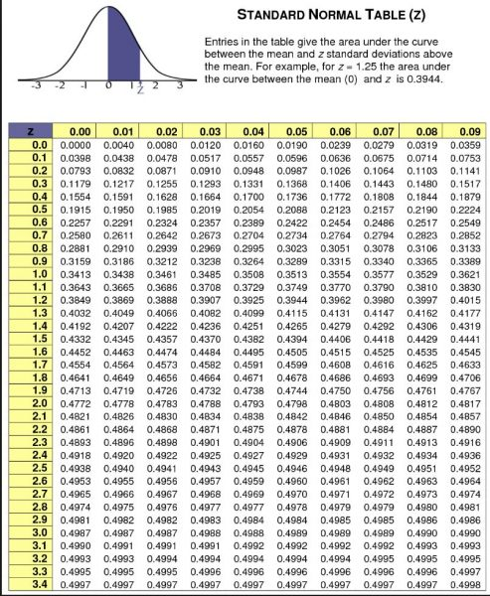

Slide 70
Standard Normal Z Table
Z | .00 | .01 | .02 | .03 | .04 | .05 | .06 | .07 | .08 | .09
0.0 | 0.5000 | 0.5040 | 0.5080 | 0.5120 | 0.5160 | 0.5199 | 0.5239 | 0.5279 | 0.5319 | 0.5359
0.1 | 0.5398 | 0.5438 | 0.5478 | 0.5517 | 0.5557 | 0.5596 | 0.5636 | 0.5675 | 0.5714 | 0.5753
0.2 | 0.5793 | 0.5832 | 0.5871 | 0.5910 | 0.5948 | 0.5987 | 0.6026 | 0.6064 | 0.6103 | 0.6141
0.3 | 0.6179 | 0.6217 | 0.6255 | 0.6293 | 0.6331 | 0.6368 | 0.6406 | 0.6443 | 0.6480 | 0.6517
0.4 | 0.6554 | 0.6591 | 0.6628 | 0.6664 | 0.6700 | 0.6736 | 0.6772 | 0.6808 | 0.6844 | 0.6879
0.5 | 0.6915 | 0.6950 | 0.6985 | 0.7019 | 0.7054 | 0.7088 | 0.7123 | 0.7157 | 0.7190 | 0.7224
0.6 | 0.7257 | 0.7291 | 0.7324 | 0.7357 | 0.7389 | 0.7422 | 0.7454 | 0.7486 | 0.7517 | 0.7549
0.7 | 0.7580 | 0.7611 | 0.7642 | 0.7673 | 0.7704 | 0.7734 | 0.7764 | 0.7794 | 0.7823 | 0.7852
0.8 | 0.7881 | 0.7910 | 0.7939 | 0.7967 | 0.7995 | 0.8023 | 0.8051 | 0.8078 | 0.8106 | 0.8133
0.9 | 0.8159 | 0.8186 | 0.8212 | 0.8238 | 0.8264 | 0.8289 | 0.8315 | 0.8340 | 0.8365 | 0.8389
1.0 | 0.8413 | 0.8438 | 0.8461 | 0.8485 | 0.8508 | 0.8531 | 0.8554 | 0.8577 | 0.8599 | 0.8621
1.1 | 0.8643 | 0.8665 | 0.8686 | 0.8708 | 0.8729 | 0.8749 | 0.8770 | 0.8790 | 0.8810 | 0.8830
1.2 | 0.8849 | 0.8869 | 0.8888 | 0.8907 | 0.8925 | 0.8944 | 0.8962 | 0.8980 | 0.8997 | 0.9015
1.3 | 0.9032 | 0.9049 | 0.9066 | 0.9082 | 0.9099 | 0.9115 | 0.9131 | 0.9147 | 0.9162 | 0.9177
1.4 | 0.9192 | 0.9207 | 0.9222 | 0.9236 | 0.9251 | 0.9265 | 0.9279 | 0.9292 | 0.9306 | 0.9319
1.5 | 0.9332 | 0.9345 | 0.9357 | 0.9370 | 0.9382 | 0.9394 | 0.9406 | 0.9418 | 0.9429 | 0.9441
1.6 | 0.9452 | 0.9463 | 0.9474 | 0.9484 | 0.9495 | 0.9505 | 0.9515 | 0.9525 | 0.9535 | 0.9545
1.7 | 0.9554 | 0.9564 | 0.9573 | 0.9582 | 0.9591 | 0.9599 | 0.9608 | 0.9616 | 0.9625 | 0.9633
1.8 | 0.9641 | 0.9649 | 0.9656 | 0.9664 | 0.9671 | 0.9678 | 0.9686 | 0.9693 | 0.9699 | 0.9706
1.9 | 0.9713 | 0.9719 | 0.9726 | 0.9732 | 0.9738 | 0.9744 | 0.9750 | 0.9756 | 0.9761 | 0.9767
2.0 | 0.9772 | 0.9778 | 0.9783 | 0.9788 | 0.9793 | 0.9798 | 0.9803 | 0.9808 | 0.9812 | 0.9817

Slide 71
Example 1: Exam Scores
A teacher claims that the average exam score in her class is 75. A random sample of 36 students has an average score of 72, and the standard deviation is 6.Test the claim at 5% level of significance.
Example 2: Daily Water Consumption
It is believed that people drink on average 2.5 liters of water per day. A health survey of 30 people shows an average of 2.2 liters, with a standard deviation of 0.5 liters. Test if the actual average water consumption is different, at 1% significance level.
Example 3: A city claims that the average commute time to work is 30 minutes. A researcher takes a random sample of 25 workers and finds a sample mean commute time of 29.5 minutes, with a standard deviation of 3 minutes. Test whether the average commute time is different from the city's claim at a 5% significance level.

Slide 72
Example 1: Exam Scores
A teacher claims that the average exam score in her class is 75. A random sample of 36 students has an average score of 72, and the standard deviation is 6.Test the claim at 5% level of significance.
Since the test statistic z = -3 is less than -1.96
Example 2: Daily Water Consumption
It is believed that people drink on average 2.5 liters of water per day. A health survey of 30 people shows an average of 2.2 liters, with a standard deviation of 0.5 liters. Test if the actual average water consumption is different, at 1% significance level.
Since the test statistic z ≈ -3.29 is less than -2.576, it falls in the rejection region.
Example 3: A city claims that the average commute time to work is 30 minutes. A researcher takes a random sample of 25 workers and finds a sample mean commute time of 29.5 minutes, with a standard deviation of 3 minutes. Test whether the average commute time is different from the city's claim at a 5% significance level.
Since the test statistic z = -0.833 is between -1.96 and 1.96, it falls in the accepted.

Slide 73
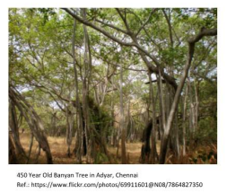
Literature Definition and General Characteristics
A body of work that has been distributed, written or published on a given topic or concept
Can be in multiple formats, depending on the academic subject or discipline
Various intents: inform, support, persuade, update, or dispute

Slide 74
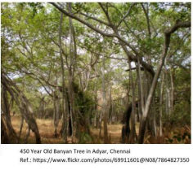
General Characteristics of Literature
The literature consists of the following :
Major works : key or seminal publications on a topic
Other works or publications that build upon or respond to the major works.
The literature is a continuously evolving network of scholarly works that interact with each other.
The banyan tree in the adjoining picture is an analogy for the growing body literature that enhances our knowledge of the Universe

Slide 75



Types and Sources of Literature
Literature falls into three categories : Primary, Secondary and Tertiary Sources
PRIMARY LITERATURE
Original research and / or new scientific discoveries
Immediate results of research activities
Often includes analysis of data collected in the field or laboratory
EXAMPLES
Original research published as articles in peer – reviewed journals
Dissertations
Technical reports
Conference proceedings
SECONDARY LITERATURE
Summarizes and synthesizes primary literature
Usually broader and less current than primary literature
EXAMPLES
Literature review articles
Books
Since most information sources in the secondary literature contain extensive bibliographies, they can be useful for finding more information on a topic
TERTIARY LITERATURE
Summaries or condensed versions of materials
Usually with references to primary or secondary sources
Good place to look up facts or get a general overview of a subject
EXAMPLES
Textbooks
Dictionaries
Encyclopedias
Handbook

Slide 76
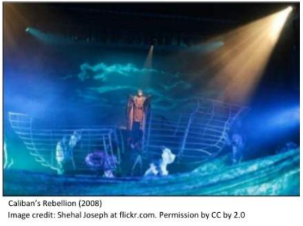
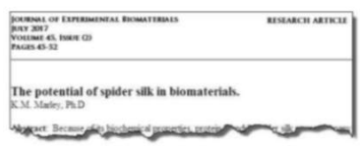
Primary Sources of Literature
1. Primary Sources: first-hand accounts of events, practices, or conditions being researched.
It also includes many original, creative works or artifacts.

Slide 77
Primary Sources of Literature
Primary Source Examples:
Humanities :
Creative works (original literature, fiction or non-fiction, poetry, film, performances)
Music scores handwritten by the composer(s)
Diaries
Regalia or original artefacts
Magazine or newspaper articles
Autobiographies
Memoirs
Oral histories
Field notes
Raw data
Statues and laws
Sciences/Health Sciences :
Original research (articles, reports, pre-prints).
Conference papers
Interviews
Dissertations & theses
Patents & invent ions
Technical reports
Lab notebooks
Raw data
Social sciences tend to use a combination from these broad disciplines.

Slide 78


Secondary Sources of Literature
Secondary Sources: sources that discuss, study, or comment on information from primary sources

Slide 79
Secondary Sources of Literature
Secondary Source Examples:
Humanities:
Biographies
Literary criticism
Monographs written about a topic
Reviews on creative works
Music scores that have been published or changed
Bibliographies
Law reviews
Journal articles (criticism and interpretation
Sciences/ Health Sciences :
Literature reviews
Data analysis or refined compilations
Reviews (systematic or meta-analysis)Opinion pieces*
Letters to the editor
Articles in trade journals (non-research)
Text books and books

Slide 80
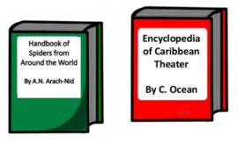
Tertiary Sources of Literature
Tertiary Sources: sources that utilize and distill information from primary and secondary sources.
Reference works such as :
Handbooks
Standards
Almanacs
Encyclopedias
Manuals
Pathfinders (Lib Guides)

Slide 81
Information and Communication Technology (ICT) plays a crucial role in education, and it has been widely studied in the context of schools and higher education. Here are some key points related to ICT-enabled tools for literature surveys:
A review of research on ICT integration in education highlights its merits, challenges, and factors influencing successful implementation.
ICT is considered a powerful tool for educational change and reform, improving educational quality and connecting learning to real-life situations.
Researchers can use various tools to conduct literature reviews. These tools help organize, analyze, and synthesize existing research.
Some popular tools include JSTOR, Google Scholar, and PubMed, which provide access to scholarly articles and research papers.

Slide 82

Literature Survey vs. Literature Review
The Literature Survey only searches
information or penetrates through
available literature. It is the process
of identifying and locating scholarly
information and publications on a
particular topic.
The Literature Review on the other hand examines the information to determine the findings and contribution to the topic and establish the base upon which any new work would stand. It is the critical review of the literature survey.
Literature Survey and Literature Review go hand-in-hand simultaneously

Slide 83
Significance of Literature Survey and Review
It is one of the first things done by any student or scholar who plans to pursue new knowledge or do research in any subject area.
Time consuming, but helps widen the knowledge base on the topic
Understand the contribution from other researchers
Define the gaps of knowledge
Understand the current status and challenges involved
Understand advantages and disadvantages of current system
Trigger the critical thinking process and zero in the research problem to formulate the problem statement

Slide 84
Significance of Literature Survey and Review
This is important to understand the approach and methodology adopted by previous researchers and learn from their experiences.
Some questions that will help in this task are:
Why you need to pursue research in the selected area?
How are you going to pursue the research?
What are the constraints of pursuing the research?
Which laboratory is to be used for experimentation?
Is the topic latest or demanding?
Which is the best method for the experimentation?
What are the limitations of existing technique?
Is the research topic feasible?
Does the problem statement have substantial research component?
Is there any social use for the selected topic?
Does it harm the society?
Is there any parallel research being pursued by another person in the selected area?

Slide 85
Significance of Literature Survey and Review
This will lead to critical information that can be incorporated in the introduction section of documents / thesis such as:
Introductory detail of the area of interest
Methodology used for the topic to be studied
Broad overview of the topic to be studied
Name of the authors / researchers who are authorities in the area of interest
Important happenings or events in the area
Keywords and subject related to the vocabulary terms, which can be used to search the
database
Local, national and international status of the work
References and bibliographies that can lead to additional search
Explanation about the fundamental study conducted in the past
The important historical dates and events of the major work carried out related to the
topic
The information why and in what way the research problem is important

Slide 86
Literature Review Strategy
As literature review is a written summary of journal articles, books, and other documents that describes the past and current state of information on the topic of your research study.
Steps in literature review are:
Identify key terms
Locate literature
Critically evaluate and select the literature
Organize the literature
Write a literature review
(Record of research review)
Research Question
Refocus
Focus
Literature Survey
Evaluate and Record
Review and Revise
Sources
Keywords
Search Results
Update
Synthesize
Literature Review

Slide 87
Identify Key Terms (Keywords)
The words that are typed into a search box are the key to finding the most relevant articles and books. That's why they're called keywords! They need to chosen carefully for effective literature search.
Write a preliminary "working title" for a project with a brief description.
Use that to pose a short, general research question (this maybe based on your hypothesis if you already have identified one)
Use this to identify the keywords in the question and write down the synonyms using a thesaurus.
Alternatively, the keywords reported by authors in their publications maybe used

Slide 88
Identify Key Terms (Keywords)
Let us take an example:*
Hypothesis is: "Online classes does not enhance learning by students“
Research question: "Does the use of online classes help students learn?“
Key concepts and key words: Online classes, Students and Learn
Probable synonyms that maybe used for searching are:
Students | Online Classes | Learn
learners | online course | Learning
college students | distance education | Success
Undergraduates | zoom | performance
 | google meet | grades

Slide 89
Locate Literature Public and Private Sources
Public sources such as:
Central government departments - Defense, Energy, Science and Technology etc.
State and local governments - Highways, Pollution Control Board etc.
Universities Libraries Internet-free search engines based such as google scholar
Private sources are:
Non-profit organizations and services - Professional societies, trade associations, membership organizations
Profit-oriented organizations - Manufacturers, vendors' catalogues, samples, consultants etc.
Individuals-Direct conversation or correspondence, personal friends, faculty

Slide 90
Locate Literature Online Databases - Introduction
Online databases:
Database is a collection of records.
Computer database is a collection of data presented in a searchable format on computer and some of them are present online.
Online databases are web-based electronic indexes to locate and retrieve articles, magazines, journals and newspapers.*
Types of online databases
Multidisciplinary (comprehensive) vs. subject specific
Full text vs. citation only

Slide 91
Locate Literature List of Online Databases
Some important online databases are:
ERIC database-www.eric.ed.gov - US Dept. of Education
Psychological abstracts-www.apa.org - Am. Psych. Assoc.
EBSCO Information services - www.ebsco.com-US Pvt. Co.
Web of Science - online service by Clarivate Analytics providing access to Science Citation Indexing (SCI), SCI-Expanded (SCIE),Emerging SCI (ESCI), Social SCI (SSCI)
Sociological Abstracts - ProQuest, USA
Dissertation Abstracts - ProQuest, USA
Chemical Abstracts - 1907 to 2009 by American Chemical Society
Chemical Abstract Service (CAS) - American Chemical Society
Scopus - Elsevier, Netherlands
PubMed Central - NIH, USA
Google Scholar - Google Inc., USA
Indian Citation Index-ICI, India

Slide 92
Reference Searching and Types
Once a high-impact or key publications on a topic is located, the search can taken further by looking at the references or works cited In those articles. This is called reference searching and is also known by a few different terms: pearl growing, chain searching, and citation mining.
The different types of reference searching are:
Systematic-try to find all relevant materials using keywords. This is discussed in detail a later section.
Retrospective - find the most recent material and work backwards (Backward Searching or Snowball Method).
Citation-follow up references from useful articles, book and reading lists (Forwarding Searching).
Targeted-restrict your topic and focus on a narrow area of the literature
The result produced at the end of a literature search is usually a list of references

Slide 93
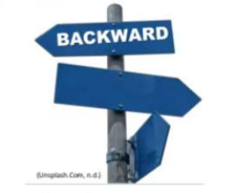
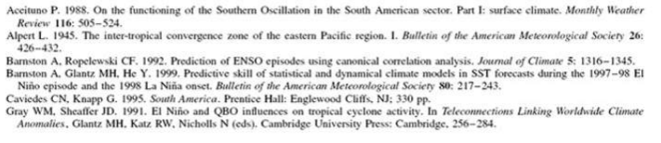
Reference Searching Retrospective Type - Backward Searching
Backward reference searching, also known
as chain searching or snowball method, involves
identifying and examining the references or works
cited in an article. It is done for the following reasons:
Learn about the development of knowledge on a topic.
Study the origins and development of a theory, construct, or model of interest.
Identify experts, institutions or organizations that specialize in a topic of research.

Slide 94
Reference Searching Retrospective Type - Backward Searching
A second-level or second-generation backward reference
search is when a researcher examines sources cited by
the references used in an initial article. This allows a
researcher to identify inconsistencies in the
literature.
Third-level or third-generation searches are where the references of articles located in a second-level or second- generation reference search are examined. These searches can also go further back.
Backward Author Searching. The works of an author can be examined by doing a backward reference search. This allows a researcher to review an author's previous work and publications, and also the development of their research

Slide 95

Reference Searching Citation Type-Forward Searching
Forward reference searching is when a researcher
identifies articles that cite an original article or
work after it had been published. This type of
search focuses on the publications created
after an article's publication.
Forward reference searching helps a researcher do the following:
Expand their knowledge on a topic by locating follow-up studies.
Identify new findings and developments on a topic
Examine and consider other methodologies or analyses used to study a topic.
Forward Author Searching. Forward reference searching can also be done to find a particular author and his or her works. This allows a researcher to review an author's later or more current works, and also examine new developments

Slide 96
Review Articles - Definition
A review article is a:
A critical, constructive analysis of the literature in a specific field through summary, classification, analysis, comparison.
A scientific text relying on previously published literature or data. New data from the author's experiments are not presented (with exceptions: some reviews contain new data).
A stand-alone publication. Literature reviews as integral parts of master theses, doctoral theses or grant proposals will not be considered here. However, many tips in this guideline are transferable to these text types.

Slide 97
Review Articles - Function and Audience
The function of a review article is to:
Organize and evaluate literature
Identify landmark events in the field
Summarize the current state of understanding on a topic
Identify patterns, debates and future trends
Identify gaps and recommend new research areas
The audience of review articles are:
Experts in specific research areas
Students or novice researchers
Decision-makers

Slide 98
Review Article vs. Research Article
Research articles are primary literature sources. So, they report the methods and results of original studies performed by the authors.
Review articles are secondary sources. It is a survey and attempt to provide an overview of the current state of understanding on topics.
Review Article
Identifies previously published
research on a topic and
summarize the information
(secondary source).
Discusses what is already known
and can be used to identify gaps
in the field.
Usually no set layout
No original research is being
presented.
Written for a more general
audience and easier to read
Research Article
Follows the scientific method.
Usually provides a brief background on prior research (introduction).
Conducts an experiment and reports the findings.
Authors have NEW original research data (primary source) and discusses their results.
Written at an advance level;
usually contains lots of jargon
Both
Written by subject expert such as a scientist or researcher.
Can be published in a scholarly, peer – reviewed journal.

Slide 99
Classification of Review Articles
Review articles maybe classified into three types - Methodological, Objective and Mandate based types.
Methodological Approach and it types
Narrative Review:
Selected studies are compared and summarized on the basis of the author's experience, existing theories and models.
Results are based on a qualitative rather than a quantitative level.
Best Evidence Review
A focus on selected studies is combined with systematic methods of study-selection and result exploration.
Systematic Review :
Findings from various individual studies are analysed statistically by strict procedures.
Meta-Analyses are used to pool the results of individual studies

Slide 100
Classification of Review Articles
Review articles maybe classified into three types Methodological, Objective and Mandate based types
Objective Approach and its types
Status-quo Review
Presentation of the most current research for a given topic or field of research.
History Review
Development of a field of research over time.
Issue Review
Investigation of an issue (i.e. a point of disagreement or a question) in a specific field of research.
Theory/model Review
Introduction of a new theory or model in a specific field of research

Slide 101
Classification of Review Articles
Review articles maybe classified into three types - Methodological, Objective and Mandate based types.
Mandate Approach and its types:
Invited Reviews:
Experienced researchers are invited by the journal editors to write reviews when the editors feels that the research has progressed enough in the topic to overview the topic again.
Commissioned Reviews:
Formal contracts of authors with clients to write and submit reviews
Unsolicited Review Submissions:
Individual or group of researchers develop an idea for a review and submit it to journal editors

Slide 102
Classification of Literature Review Another Approach
Topical order - organize by main topics or issues
Chronological order - organize by dates the research was published
Problem-cause-solution order - organize by moves from problem to the solution
General-to-specific order (Funnel approach)-examine broad-based research first and then focus on specific studies that relate to the topic
Specific-to-general order - discuss specific research studies so conclusions can be drawn

Slide 103
Review Article - Organization
Title - Helping readers to decide whether they should read the text or not
List of Authors - Declare intellectual ownership of the work and provide contact information
Abstract - Informs about the main objectives and result of the review article
Table of Contents - Shows the readers the organization of the text. Helps orientation among sections.
Introduction - provides information about the
Context (one or two paragraphs)
Motivation for review (one paragraph)
Focus (one paragraph). Research question (one paragraph) and
Text structure (one paragraph)

Slide 104
Review Article - Organization
6. Body-Materials and Methods
Systematic and best evidence reviews have a methods section.
Narrative reviews do not have a methods section but should include some information about applied methods at the end of the introduction.
7. Body-Main Review - A coherent structuring of the topic is necessary to develop the section structure. Subheadings reflect the organization of the topic and indicate the content of the various sections. Possible criteria for structuring the topic are:
Methodological approaches
Models or theories
Extent of support for a given thesis
Studies that agree with another versus studies that disagree
Chronological order
Geographical location

Slide 105
Review Article - Organization
8. Conclusion –
Answer the research question set in the introduction.
States the implications of the findings and an identifies possible new research field.9.
9. Acknowledgements - Expresses gratitude to
People who helped with the literature review, but whose contribution is too small to justify co-authorship.
Funding organisation and specifies the funding program (often required by funding agencies).
10. References ("Literature Review") - organised by number in the order they were cited in the text.
Shows interested readers how to find the literature mentioned in the text.
Acknowledges the work of other scientists.
Compulsory to avoid charges of plagiarism

Slide 106
Meta Analysis: "Analysis of an Analysis“
Coined by Gene V. Glass in educational research
Meta-analysis is quantitative approach for systematically combining results of previous research to arrive at conclusions about the body of research.
Quantitative : Numbers
Systematic : Methodical
Combining : Putting together
Previous Research : What's already done
Conclusions : New knowledge (stronger than the analysis of any single study)
Meta-analysis is a set of statistical techniques for combining data from independent studies that share a hypotheses to produce a single estimate of an effect.

Slide 107
Meta Analysis: “Analysis of an Analysis”
Meta-analysis is often part of the systematic review process. It is used when you are comparing multiple studies that looked at similar relationships.
Meta -Analysis
Overview
Systematic Review
Systematic
Review
Meta Analysis
Practice Guideline
Randomized Controlled Trail
Cohort Study
Case Control Study
Case Report

Slide 108
Advantages of Meta - Analysis
Results can be generalized to a larger population
Precision and accuracy of estimates can be improved as more data is used
Inconsistency of results across studies can be quantified and analyzed
Hypothesis testing can be applied on summary estimates
Moderators can be included to explain variation between studies
Presence of publication bias can be investigated

Slide 109

Research Journal Indexing and Quality Standards Factors Necessitating Development of Journal Citation Indexing
There are three factors that led to development of citation indexing back in 1950's:
Followed by World War II, there were huge influx
of government funds for research. Publication of
research finding by researchers burgeoned the
body of knowledge. In order to retrieve from the
huge document database, it became necessary to
index it. Manual indexing practice is time consuming
and not a cost effective one.
The then method of subject indexing was not useful
because of discipline specific terminology etc.
Availability of machines for computation of data spurred citation indexing
Citation Indexing proposed and developed by Eugene Garfield

Slide 110
Research Journal Indexing and Quality Standards
When a manuscript is ready for submission, from the researcher perspective, the criteria used for selecting the journal is the it's subject focus, however, other factors such as good reputation with indexing in major databases also needs to be considered.
This subject focus + reputation + indexing ensures:
Good potential for exposure of the work to research community
Greater chance of being discovered and cited by other researchers
Greater potential for garnering citations, thereby be able to track the opinion of other researchers and learn how the work contributed to the science and society.
The reputation of the journal is judged by quality standards as assessed by impact factor and source normalized impact factor.
From the research journal's perspective, the prestige of the journal is determined by the abstracting and indexing services covering it, which in turn is linked to the citations received by articles published in it

Slide 111
Citation Indices
The first modern citation index was suggested by information scientist Eugene Garfield in 1955 and created by him in 1964, and it represents an important innovation to knowledge organization and information retrieval.
Current important citation indices are:
Clarivate Analytics citation indices (WoS) - Science Citation Index (SCI); Science Citation Index Expanded (SCIE); Social Sciences Citation Index (SSCI); Arts & Humanities Citation Index (A&HCI); Conference Proceedings Citation Index (CPCI); Book Citation Index (BKCI); Data Citation Index Emerging Source Citation Index (ESCI)
CiteSeerx-since 1997, mainly computer and info. science
Crossref-since 2000 by Publishers Association using the DOI
Scopus Citation Index (Scopus) - since 2004 by Elsevier, largest database
Google Scholar (GS)-since 2004 by Google Inc., but poor metrics
Microsoft Academic (MA)- since 2016, poor bibliometrics tool
Dimensions-since 2018 by Digital Science

Slide 112
Important Citation Indices Web of Knowledge/Science based by Clarivate Analytics
Science Citation Index (SCI) and Science Citation Index Expanded (SCIE)-(established 1964, database 1899 to present)
A multidisciplinary database, with searchable author abstracts, covering the journal literature of the sciences.
It indexes more than 6,650 major journals across 150 scientific disciplines.
Social Science Citation Index (SSCI) - (established 1973, database 1898 to present)
Covering journal literature of the social sciences It indexes more than 1,950 journals spanning 50 disciplines
Arts & Humanities Citation Index (A&HCI) -(established 1978, database 1975 to present)
Covering the journal literature of the arts and humanities
It indexes more than 1,395 of the world's leading arts and humanities journals.

Slide 113
Important Citation Indices
Conference Proceedings Citation Index-Science (CPCI-S) - (established in 2008, database from 1991 to present)
Lets you use cited reference searching to see the full impact of conferences and other professional meeting
With a global coverage of over 110,000 conference proceedings
Conference proceedings Citation Index-Arts & Humanities (CPCI-A&H)-(established in 2008, database 1991 to present)
This citation index covers conference literature in all fields of social sciences, arts and humanities.
Scopus Database based by Elsevier
Scopus (established in 2004, database mainly 1996 to present)
Largest abstract and citation database of peer-reviewed literature: scientific journals, books and conference proceedings
Created by extracting records from child databases and enhanced with their cited references
Bibliometric data poor maintained for prior 1996 records

Slide 114
Principles Underlying Journal Impact Factor
Journal Impact Factor (JIF): Clarivate Analytics (which used to be a part of Thomson Reuters till 2016) publishes JIF in a periodic journal called Journal Citation Reports (JCR) to be used as a quality measure.
JIF is a part of Web of Science (WoS) database. Clarivate owns and operates a collection of subscription-based services focused largely on analytics which includes Web of Science (WoS).
JIF is calculated by as the average of the sum of the citations received in a given year to a journal's previous two years of publications (linked to the journal, but not necessarily to specific publications) divided by the sum of "citable" publications in the previous two years.

Slide 115
Computation of Journal Impact Factor
Consider a journal, SRMIST journal that has been published in 2018, 2019 and 2020.
Total number of articles published in 2018 = 130
Total number of articles published in 2019 = 170
SRM’s total number of articles published in 2018 and 2019, say A = 300
So, SRMIST journal had a total of 300 publications in 2018 and 2019 which had a potential to be cited as a reference by articles that appeared subsequent years, say in 2020 in various journals.
Please note that there is a possibility that some of the 300 publications are poor quality that would not attract any citations in 2020. Also, some of the articles might be extraordinary enough to attract very high citations in the future years. Hence, different articles will attract different number of citations. All these citations put together regardless of which article attracted how many citations go onto define the magnitude of B.

Slide 116
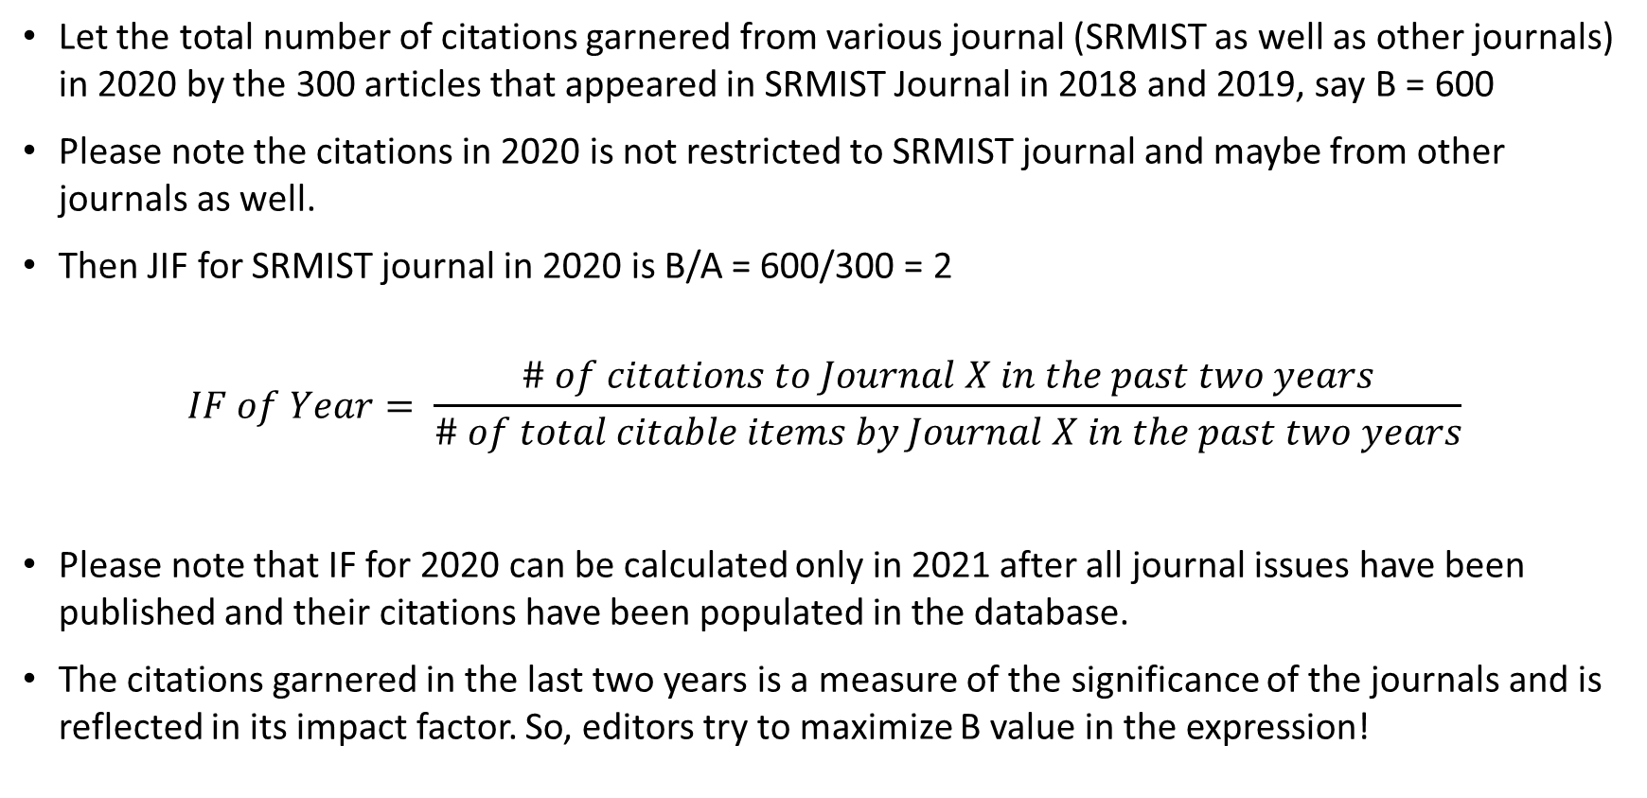
Computation of Journal Impact Factor
Let the total number of citations garnered from various journal (SRMIST as well as other journals) in 2020 by the 300 articles that appeared in SRMIST Journal in 2018 and 2019, say B = 600
Please note the citations in 2020 is not restricted to SRMIST journal and maybe from other journals as well.
Then JIF for SRMIST journal in 2020 is B/A = 600/300 = 2
$$IF of Year= \frac{\# of citations to Journal X in the past two years}{\# of total citable items by Journal X in the past two years}$$
Please note that IF for 2020 can be calculated only in 2021 after all journal issues have been published and their citations have been populated in the database.
The citations garnered in the last two years is a measure of the significance of the journals and is reflected in its impact factor. So, editors try to maximize B value in the expression!

Slide 117
Merits of Journal Impact Factor
Authors prefer to publish in higher impact factor journals because:
Higher citations rate means article has higher chances of getting cited
Higher reading rate means article gets read by more researchers
More recognition in terms of scholarly contribution
JIF provides an input about how frequently an average article in a journal has been cited in a particular year
JIF informs us about the prestige of a journal as a whole
Editors use it to judge the popularity of their journals and strive to enhance the JIF by choosing good articles that have potential to garner more citations and eliminate ones that might not.
In libraries, it is a tool used for management of library journal collections (unsubscribe from low JIF ones)
In market research, publishers use it as a quantitative evidence about the popularity of their journals

Slide 118
Demerits of Journal Impact Factor
JIF is an average statistic and not all articles are equally cited. So, an article having fewer citations published in a high IF journal is given more importance than a highly cited article in a low IF journal.
Only includes "citable" articles in the denominator of the equation, i.e., articles and reviews
Only a limited subset of journals is indexed by Clarivate Analytics
While calculating JIF, self citations are also counted.
Tell us nothing concrete about any specific paper or specific author
Review articles are generally highly cited. Publication of more number of review papers in a journal can greatly affect the journal's IF.
IF depends on the size of the field concerned. A larger field size would draw more citations than the one having a small size.
Biased toward English language journals and JCR is also expensive

Slide 119
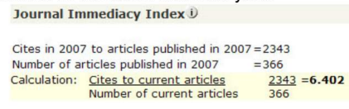
Journal Immediacy Index
Journal Immediacy Index (JII) is also reported in JCR and is a measure about how topical or state-of-the-art the topic of a published article might be.
This is measured by how quickly a published article in a given journal is cited in the same calendar year.
It is the ratio of total citations for a journal's articles published during a calendar year divided by the total number of articles published in the same calendar year.
Journals that publish only review articles such as "Chemical Reviews are likely to garner more citations in the same year due to wide applicability of the review articles.

Slide 120
h-index (Hirsch index):
The h-index was suggested in 2005 by Jorge E. Hirsch, a physicist at UC San Diego, USA and hence also called as "Hirsch Index".
It is a metric for evaluating the cumulative impact of an author's scholarly output and performance
It combines an assessment of both quantity (number of papers) and quality (impact, or citations to these papers)
It is automatically calculated by citation indexing agencies such as Web of Science, Scopus, Google Scholar etc. But, it can also be calculated manually.
The index can also be applied to the productivity and impact of a scholarly journal as well as a group of scientists, such as a department or university or country

Slide 121
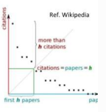
h-index (Hirsch index)
The h-index is defined as the maximum value of h such that the given author/journal has published "h" papers that have each been cited at least "h" times.
For example consider the tabulation for "rank of article" vs. "decreasing number of citations for a particular author.
The articles are listed in decreasing order of number of citations and then plotted for serial number of article vs. number of citations as shown in the plot.
A diagonal line is drawn across the plot that shows that the h-index is 5. This can also be inferred from the table, where the article serial number and number of citations match
Articles | Citations
1 | 46
2 | 25
3 | 12
4 | 11
5 | 5 = H - Index
6 | 4
7 | 2
8 | 1

Slide 122
Factors influencing h-index
The h-index of a particular author may vary from one database to another, depending on the coverage of each database.
Co-publishing can elevate the h-index, because it does not take the order of authorship into account.
Time helps to increase the h-index; young researchers generally2have a low h-index.
The subject area can have an effect on the h-Index: a researcher who publishes on a trendy subject will have a higher h-index than another one who publishes on a niche topic.
The language affects h-index; with English receiving more citations.
Open access publishing increases the visibility of articles and increase their chance to be cited.
Promotion of publications (blog posts, conferences etc.) helps to make articles more visible and increases their chance of being cited.
h-index does not eliminate self-citations!

Slide 123
Source Normalized Impact per Paper (SNIP)
SNIP is a factor released in 2012 by Elsevier based on Scopus to estimate impact of a journal article.
The measure is calculated as SNIP RIP/(R/M), where RIP = Raw Impact per Paper, R = Citation Potential and M = Median database citation potential.
SNIP corrects for differences in citation practices between scientific fields, thereby allowing for more accurate between-field comparisons of citation impact.
The main differences between the SNIP and JIF are:
Differences between SNIP and JIF
 | SNIP | JIF
Database based on | Scopus | Web of Science
Field Differences taken into account | Corrected | No correction
No. of Year of Cited Publications | Three | Two
Citation Sources | Selected sources only | All sources
Citations Referred to | Selected documents only | All types of documents

Slide 124
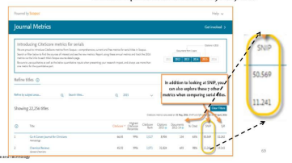

Calculation of SNIP
SNIP can be obtained from www.journalindicators.com.it can also be obtained from the Scopus' Journal Metric webpage as shown below. It can also be calculated as shown below.
$$SNIP of journal = \frac{\text{Journal}\text{′}\text{s} \text{citation} \text{count} \text{per} \text{article} }{\text{Citation} \text{potential} \text{in} \text{the} \text{subject} \text{field} }$$

Slide 125
i10-Index - Introduction and Computation
The i10-index was created by Google Scholar in 2011.
The i10-Index for a particular author is the number of publications with at least 10 citations.
It is accessible only from Google Scholar Citations profile of the author.
i10-index is a very simple measure proposed by Google Scholar, and is another way to help gauge the productivity of a scholar.
Therefore, if someone has an i10-index of 32, it means that the person has 32 papers with citations more than 10. In reality, many papers may have much more than 10 citations (say 100 or even more), but reference frame is at least 10

Slide 126
i10-Index-Introduction and Computation
Advantages of i10-IndexSerial
Very simple and straight forward to calculate
My Citations in Google65Scholar is free and easy to use
Disadvantages of i10-Index
Used only in Google Scholar
Minimum requirement is 10 citations per article, so there is no weightage for articles with more than 10 citations.
Serial No. | Number of Citation
1 | 75
2 | 68
3 | 65
4 | 60
5 | 45
6 | 15
7 | 12
8 | 9
9 | 5
10 | 0
i10 Index is 7
H Index is 8

Slide 127
Intellectual Property Rights (IPR) Definition and Motivation for IPR
Intellectual property rights are legal rights that provide creators protection for original works, inventions, or the appearance of products, artistic works, scientific developments etc.
This incentivizes discovery and creativity by providing creators with an opportunity to profit from the value of their innovative work
The IP rights are important because they can:
Used to differentiate a business from its competitors
Be sold or licensed providing an important revenue stream
Offer customers something innovative that is not available with other businesses etc.
This encourages innovation, competitiveness, knowledge economy development, jobs and economic growth and prosperity

Slide 128


Broad Classification of IPR
Intellectual property is broadly categorized into two:
Industrial Property-Patents, trademarks and designs-eg. drug molecule patent, coca cola trademark and bottle design
Literary and Artistic Property-copyright and related rights- eg. Shakespeare's literary works, Computer codes, Video recordings, Musical works, Website design, Pictures etc

Slide 129

World Trade Organization
The World Trade Organization (WTO)
is a global international organization
dealing with the rules of trade between
nations.
It is based on WTO agreements signed by
the bulk of the world's trading nations.
Its goal is to ensure that trade flows smoothly, predictably and as freely as possible between nations.
It acts as a forum for negotiating trade agreements, settling trade disputes between its members and supporting the needs of developing countries.
India is a member of WTO since inception in 1995

Slide 130

World Intellectual Property Organization
The World Intellectual Property
Organization (WIPO) was established
in 1967 and is a specialized agency of
the United Nations with 193 member states.
WIPO provides a platform with treaties, forums, standards, databases and services to register and protect IP in different countries, resolving transboundary IP disputes etc. for a balanced and accessible international IP system which will rewards creativity, stimulates innovation and contributes to economic development while safeguarding public interest.
India is a member to several WIPO conventions and treaties, thereby underlining its strong multilateral engagement with WIPO and intent to create a strong regime for IP protection

Slide 131
Trade-Related Aspects of Intellectual Property Rights Agreement
The widespread piracy, counterfeiting and IPR infringement constituted a major barrier to trade between nations, inspite of the WTO agreement.
To reduce these impediments, resolve IP related disputes and support a mutually supportive relationship between WTO and WIPO, the Trade-Related Aspects of Intellectual Property Rights (TRIPS) agreement was constituted in 1995.
Hence, TRIPS is an international legal agreement between all WTO member nations.
It establishes minimum standards for resolution of IP related trade disputes between WTO members while taking into account the domestic interests of the nations.
The Agreement is a legal recognition of the significance of links between IP and trade and the need for a balanced IP system

Slide 132
Types of Indian IPR
IPR in India can be classified as follows:
Patents (and inventions)
Design (Industrial Design)
Trademark
Copyright
Geographical Indication
Trade Secret
Patent
Trademark
Trade Secrets
IRP in India
Geographical
indication
Copyright
Utility / Model Design
Plant Breeders

Slide 133

Types of Indian IPR
Indian Patents :
A patent is used to prevent an invention from being created, sold, or used by another party without permission.
Patents are the most common type of intellectual property rights that come to people's minds when they think of IPR protection.
A patent owner has every right to commercialize the patent, including buying and selling the patent or granting a license to the invention to any third party under mutually agreed terms.
A patent has a 20 year validity under Indian Patent Act, 1970.

Slide 134
Factors to be Considered in Patenting
A patent is a "negative right" - it gives the right to EXCLUDE others from practicing your invention
All rights in patents (derive from the inventors)
Patentable vs. Non-patentable
Patentable (utility, plant and design) - le. process, machine, manufacture, or composition of matter, "everything under the sun that is made by man“
Non-patentable-abstract ideas, laws of nature, and natural phenomena

Slide 135
Factors to be Considered in Patenting
Obtaining a patent can be expensive and arduous process
Average time from filing to first response from PTO: 1.5-3 years
Average time to obtain patent: 3-5 years
Average cost of U.S. patent: US $ 20,000-40,000
Can file "continuations" (P-> C1-> C2 -> CIP)
Patent litigation is the most intellectually challenging type of IP litigation
Ultimate aim of patent is to promote public good by providing royalties for inventors & companies which invest in new inventions
Royalty rate per "use" is the monopoly price
Marginal cost=0, so revenue maximization

Slide 136
Procedures for Obtaining Patent Rights
Step 01: Invention disclosure.... with novelty and disclosure to agent if necessary
Step 02: Patentability search.... for prior art by agent
Step 03: Decision to file an application for patent..... with a inventive step
Step 04: Patent drafting.... with scope and detail
Step 05: Filing the patent application....
Step 06: Request for examination.... by the officers
Step 07: Responding to objections (if any)...
Step 08: Grant of patent.....
Step 09: Renewal of patent...

Slide 137
Intellectual Property Rights (IPR) Product Development as a Case Study
Property right-control over usage
Each right protects a different feature or aspects
Various aspects of work protected by one or more of these rights
Product Concept
Prototype
Product introduction
Product Migrations
Prior Art Search
Provisional Filings
Patent Obtainment
Continuation filings

Slide 138
Copyright Laws vs. Patent Rights
Copyright | Patent Rights
Protects expression, not ideas | Protects ideas that have been reduced to practice
Protects the use or performance of original works of literature, art, music, drama, or any other form of expression | Protects the use manufacture or sale of inventions
Life of author + 70 | 20 years from filing
Fair Use | No Fair Use, No Research Exemption

Slide 139
Copyright Laws vs. Patent Rights
Copyright | Patent Rights
Works for hire | Employee inventor owns
Protects against copying | Innocent Infringement not a defense
Protection is automatic (registration is relatively simple) | Extensive examination process before any rights granted
Originality (low bars) | Novelty and Nonobvious (high bars)
In software, copyright automatically covers the authorship in the source code | Patentability standard for software patents is strict and uncertain

